Slide 1
FedCampus: A Real-World Privacy-preserving Data Platform for Smart Campus via FL & FA
Bing Luo（罗冰）
Assistant Professor
Duke Kunshan University

Slide 2
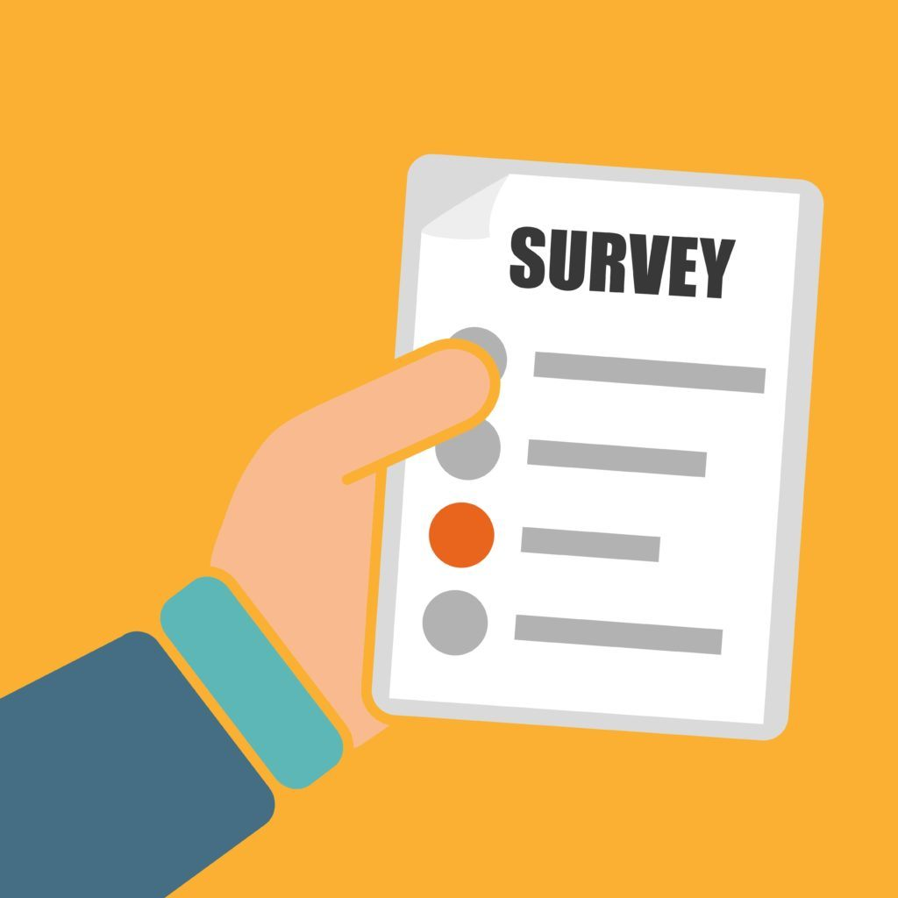

You are handed a company survey…
how your health-data is related to sleep-efficiency/depression
What is your weight?
What is your height?
How many hours do you sleep?
How many hours you spent time in exercise?
What is your resting heart rate (静息心率)?
What is your blood pressure….
The analyst claims its perfect safe as the survey is anonymous.
Will you participate?

Slide 3

Privacy Risks in Distributed Analytics…
Cmpany: utilize the database to learn people’s health statistics
You: interest about peers, but care your individual data privacy
Even anonymous, your private data is at risk.
Reason：do not know what kind of data out there can link your dataset that compromise your data privacy.

Slide 4
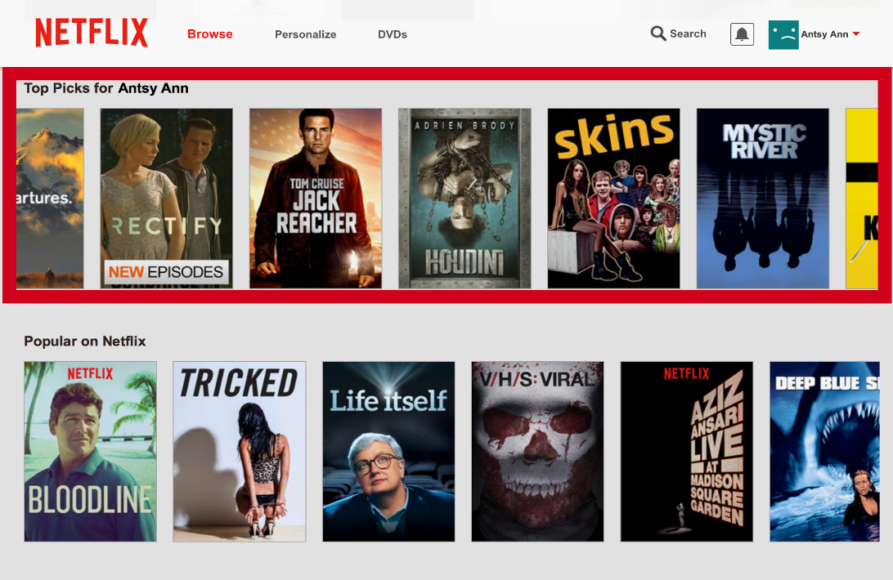

Anonymization : Not a Solution
Famous example: Netflix Prize
In 2006, Netflix announced the $1-million Prize for improving their movie recommendation algorithm.
Netflix released an anonymous dataset contained movie ratings by 500,000 subscribers.
Netflix asserted that all personal information has removed.
Useless anonymization:
One year later, two researchers from UT Austin announced they used the Internet Movie Database (IMDb) as the external source to identify the anonymous Netflix subscribers.
Question: how to learn useful statistical information from a population, but learn nothing from individuals ?

Slide 5
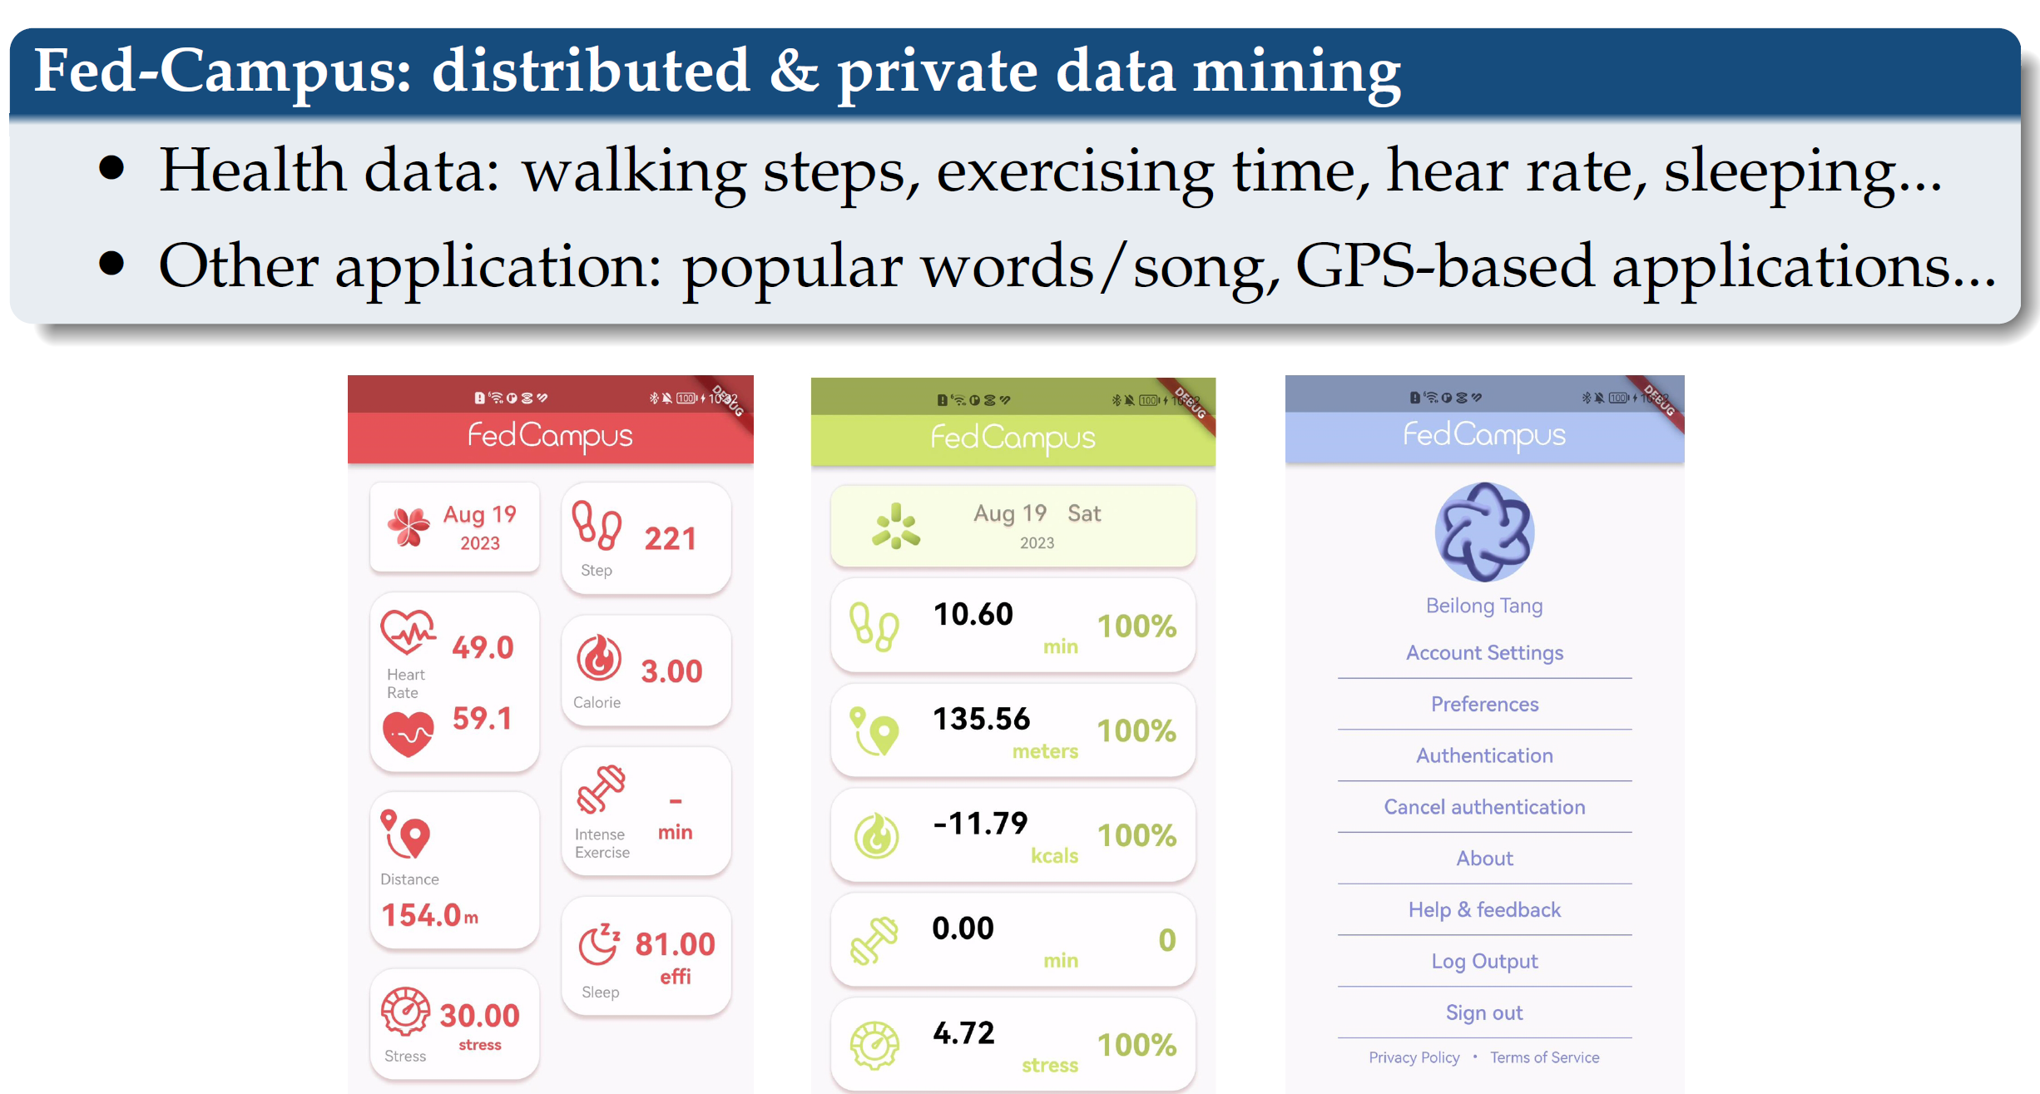
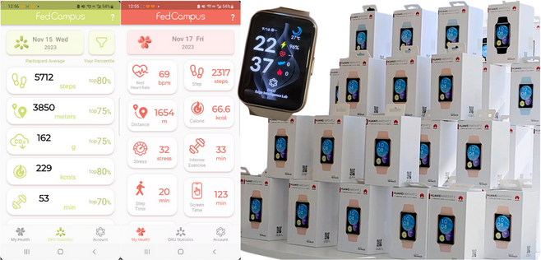

Slide 6
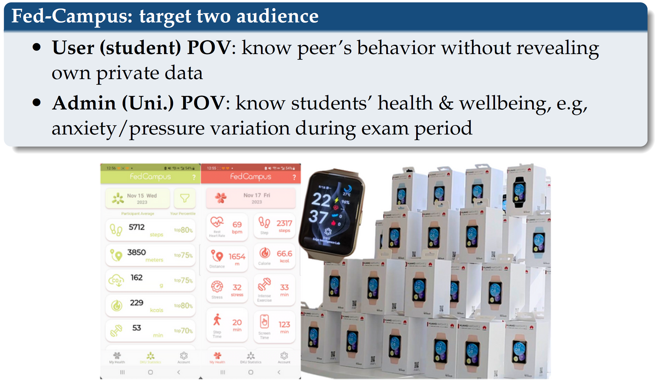

Slide 7

FedCampus (YouTube)

Slide 8
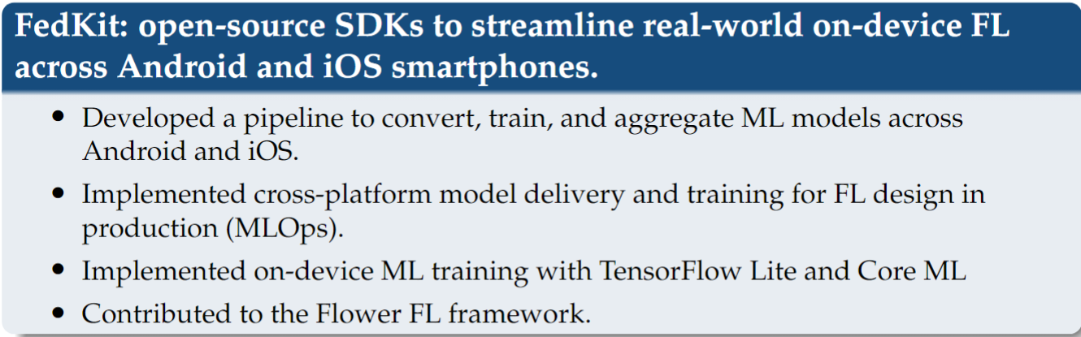
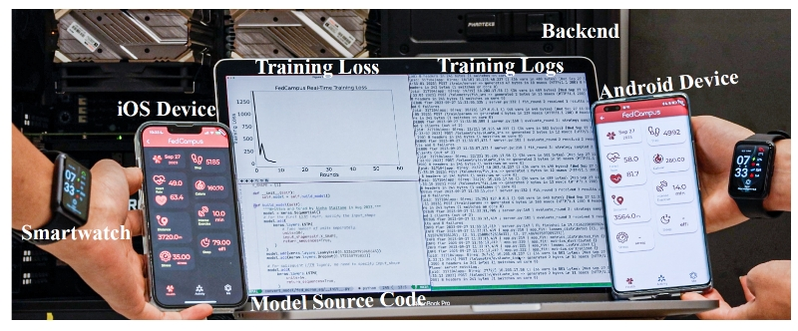

Slide 9
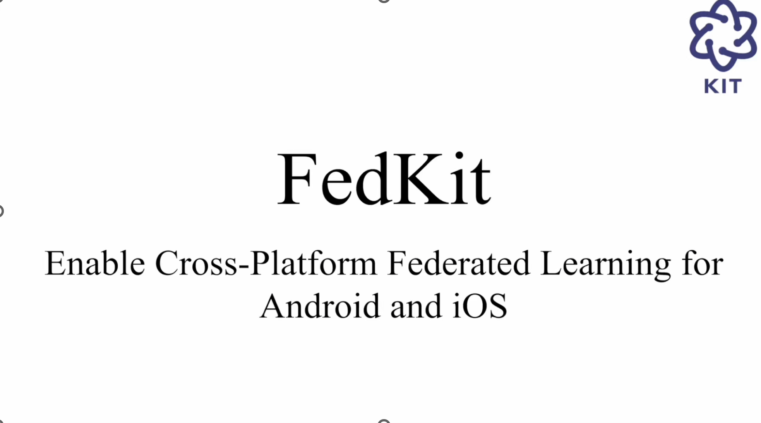
FedKiT (YouTube)

Slide 10
FedCampus: https://github.com/FedCampus FedKit: https://github.com/FedCampus/FedKit
Thanks!!

